Slide 1
The new UCAS Tariff – for entry into higher education from September 2017 onwards
Toolkit 2 for teachers and advisers
October 2015

Slide 2
Purpose
The purpose of this pack is to provide a presentation that can be used by teachers and advisers to communicate that the Tariff is changing. The slides can be adapted, supplemented or deleted as appropriate to suit the audience. This pack follows the first toolkit from September 2014, which introduced the new Tariff and explained the methodology.
Staff working in an advisory role, whether they be teachers in a formal education environment, or an adviser working with applicants in another setting, may want to use the pack in different ways with different teams. Staff working in careers, administration, or in applicant support will need an overview of why, how and when the Tariff is changing, so they are well informed.
The main objective of this pack is to help teachers and advisers understand the new Tariff, as well as developing an awareness of how universities are preparing for switchover. The pack covers:
brief overview of the changes to the new Tariff
timeline of change
how the new Tariff point systems works
what the new Tariff points look like
examples of how universities are adapting their entry requirements, offer making and processes
resources for teachers and advisers
Some notes are provided in the notes view of the slide pack to provide dditional information. The notes should be deleted before the pack is circulated. We may update this pack periodically based on your feedback. Please email newtariff-feedback@ucas.ac.uk if you have comments or ideas about how we can better support you through this change.
Notes:
Please note that some slides from Toolkit 1 have been used, to provide some background on the new Tariff. The grade examples in the appendix are also taken from Toolkit1 but they include some new Access to HE Diploma unit grade combinations as the Access to HE Diploma has been recently added to the new Tariff.
We have added these slides to avoid users of this pack having to go back to Toolkit1, as they may be useful if you are intending to do a presentation to internal teams. Any slide can be deleted or amended as you see fit, depending on how you wish to use this toolkit.

Slide 3
Contents
 |  | Page
1. | Background | 4
2. | New Tariff countdown | 5
3. | New Tariff method | 6
4. | New Tariff points | 9
5. | University examples | 11
6. | Myth busting | 15
7. | Resources for teachers and advisers | 16
8. | Practical tips and recap | 19
 | Appendix: quick reference new Tariff point grade combinations | 22
Notes:
This slide can be amended if you choose to delete certain sections/slides.

Slide 4
Background
UCAS is introducing a new Tariff for the 2017 admissions cycle – one switchover point.
Addresses many of the shortcomings of the current model.
Based on a significantly different method to the current Tariff.
Key principle is that of minimum disruption, apart from the AS repositioning to 40% of an A level.
The primary purpose of the new Tariff is to provide a broad metric for universities to use for management information and reporting purposes to HESA for the 2017-18 student record onwards.
The information and guidance material you share with students will need to be reviewed and revised.
Notes:
Now, let’s take a look at what is changing.
For applicants applying in 2016 and entering HE in 2017, the current Tariff will be replaced by the new Tariff. This entails one, singular switchover point for all, regardless of when the qualification was studied, which we hope will minimise confusion. This therefore affects your current year 12 students.
The decision to change the Tariff dates back to the 2012 Qualification Information Review, where it was deemed that the current Tariff is no longer fit for purpose. Many reasons were cited including its inflexibility to accommodate VQs and international quals, expensive and complex methodology and a lack of transparency in determining points allocations. We believe that the new Tariff addresses all of these concerns.
Moreover, a defining principle has been that of minimal disruption, so relationships between qualifications on the Tariff have been maintained as far as possible. The only key change is that of repositioning the AS in line with UK regulator statements that its demand is inferior to that of the A level.
As part of this project, we have also been keen to emphasise that we are not anticipating an increase in providers using the UCAS Tariff for entry requirements/ offer making. In fact, we have tried to reposition this metric as primarily in existence for the purpose of data management. Therefore, requirements and offers will continue to be expressed in subjects and grades where this is the case at the moment.
That said, many learners will come into contact with Tariff points, so it is imperative that we ensure that we are supporting you in revising your materials and making the necessary changes to resources.

Slide 5
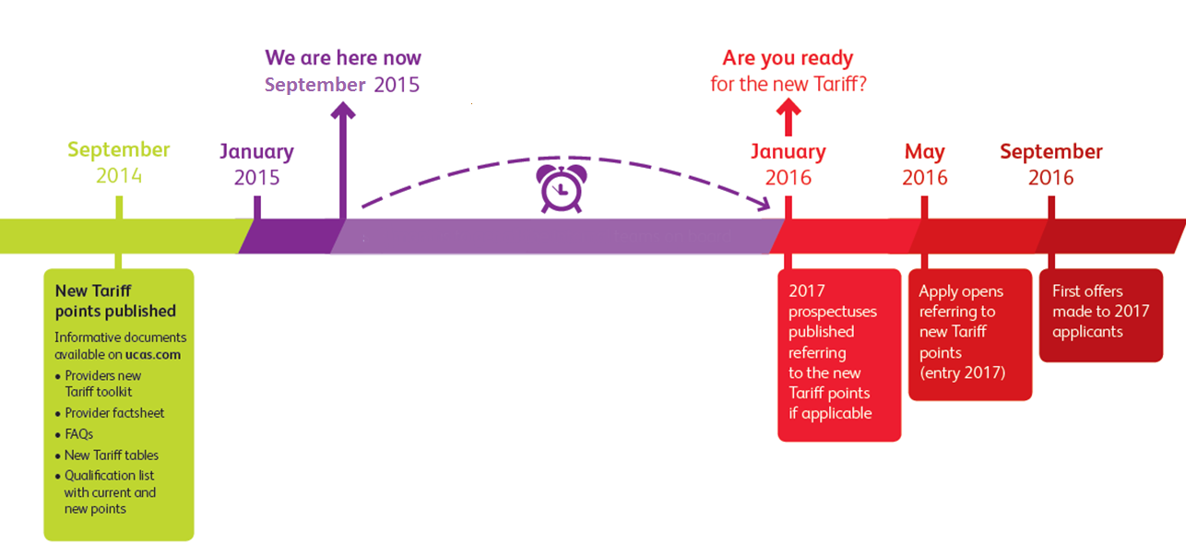
New Tariff countdown
Information published on ucas.com:
new Tariff points published
new Tariff toolkit
factsheets for learners, staff and parents/carers
new Tariff PDF tables
Four months approximately until you will see new Tariff points in university prospectuses
Notes:
This slide illustrates the key dates, to show when the new Tariff becomes real. Although precise publication dates will vary, universities will typically publish their prospectuses in January 2016, so learners can expect to ‘see’ points in their new format from that point onwards.

Slide 6
New Tariff method
Tariff points = size band x grade band
Size bands – qualifications will be allocated a size band of 1 to 4, based on their guided learning hours (notional learning hours.)
Grade bands – qualifications will also be allocated a grade band. The new Tariff has 12 grade bands across a value range of 3-14. These grade bands spread across the breadth of Level 3/SCQF Level 6.
Notes:
The new methodology has been designed to be as transparent as possible. It is a simple size by demand calculation.
The new total Tariff points will appear in the same type of Tariff Tables as the current Tariff. This means that students, teachers and advisers can focus on the new Total Tariff numbers as detailed in the new UCAS Tariff Tables.

Slide 7
Size bands
Four size bands ensure existing size relationships between qualifications are maintained whilst not over-emphasising the importance of size.
Size band | GLH/NLH | Qualifications included | GLH/NLH
1 | < 120 | Free Standing Mathematics Qualifications IB Theory of Knowledge IB Extended Essay | 60 100 50
2 | 120-219 | Extended Project Qualification AS BTEC (QCF) L3 Certificate IB Standard Certificate | 120 180 180 200
3 | 220-319 | Scottish Higher | 240
4 | 320+ | Scottish Advanced Higher A level IB Higher Certificate BTEC (QCF) L3 Subsidiary Diploma Pre-U Principal Subject | 320 360 360 360 380
Notes:
The AS remains half the size of an A level and is size band 2
Scottish Highers are allocated to a size band in between AS and A level
Scottish Advanced Higher, WBC, A levels, IB HL, Pre-U Principal Subjects are in the same size band, size band 4

Slide 8
Grade bands
A finite grade scale has been established for Level 3/SCQF Level 6 qualifications, providing 12 grade bands that all qualifications can be mapped to.
Grade points | A level | AS (new Tariff) | Scottish Highers | Scottish Advanced Highers
14 | A* |  |  | A
13
12 | A |  |  | B
11 |  |  | A
10 | B | A |  | C
9 |  |  | B
8 | C | B |  | D
7 |  |  | C
6 | D | C
5 |  | D | D
4 | E
3 |  | E
Notes:
The new Tariff uses a 3-14 point scale with 12 grade bands
Common policy is that pass/fail qualification is aligned to grade band 8
Scale starts at 3 points as 1 point does not provide a sufficient multiplier effect
The scale ensures that key UK benchmark qualifications such as Scottish Highers can be precisely positioned in agreement with UK qualification regulators
The scale is finite – for example, qualification grades operating significantly above A* at A level are considered Level 4 e.g. higher grades of Principal Subjects of Pre-U

Slide 9
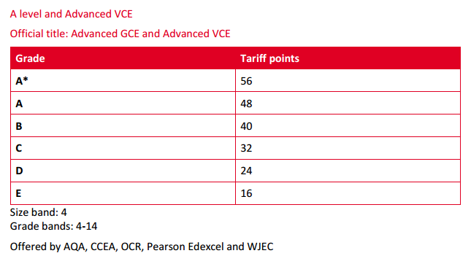
The new Tariff points
The Tariff tables show the new Tariff points, plus the awarding organisations that offer the qualification.
The size and grade bands are also shown. These bands determine the total points.
The full calculation for each qualification is shown in the qualifications list, which is a technical document primarily aimed at higher education providers.
Notes:
This is a screen shot of what the new Tariff points will look like.
Note that if you wish to see the logic driving the full calculation, there is another document on ucas.com called the qualification list where this will be detailed.

Slide 10
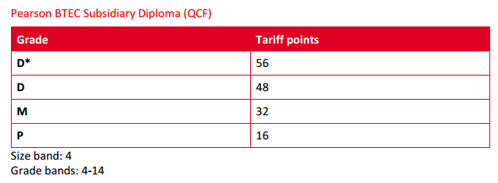
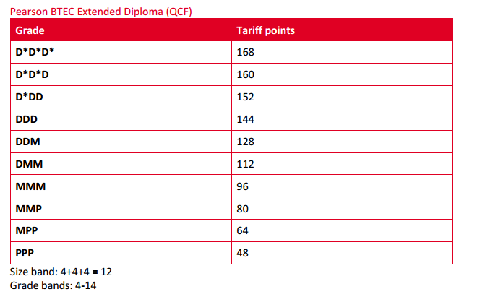
The new Tariff points
Notes:
Here you can see further extracts from BTEC qualifications, again with size bands and grade bands

Slide 11

University example: reference table
Notes:
This university example shows how Bucks New University has developed its own user reference guide to the new Tariff points. It shows common qualifications presented by its typical entry cohort so that staff can quickly work out new Tariff points.
This sort of guide could be used by a university with its feeder schools and colleges. Some universities have already started to see the new Tariff as an opportunity for supporting schools and colleges with marketing material that explains how the new Tariff will work and apply to their courses.

Slide 12

University example: current and new entry requirements
BA (Hons) Business Studies
Current Tariff requirement | New Tariff requirement
UCAS Tariff Points: 300 points required. (Minimum 200 from 2 A levels or equivalent, excluding general studies.) | UCAS Tariff Points: 120 points required. (Minimum 80 from 2 A levels or equivalent, excluding general studies.)
NB: Whilst the above accurately reflects the 2016 entry requirements in terms of the current and new Tariffs, entry requirements for 2017 have yet to be set for any course in our university and thus may change before publication.
Notes:
This slide and the two that proceed it show some possible examples from Leeds Beckett University as to how current entry requirements will be translated into new Tariff points.
Please note that these are early indications which Leeds Beckett has kindly provided to UCAS because teachers and advisers are extremely keen to see real examples of new Tariff point offers, so that they can understand the impact of the new Tariff.
Leeds Beckett have explained that they will be giving all entry requirements careful consideration to ensure they have fully thought through the impact of the repositioned AS and any other qualifications, particularly small qualifications. This is to ensure their new Tariff entry requirements can accommodate the qualifications their learners typically present, so that requirements are as clear as possible.
UCAS is very keen to share real examples with teachers and advisers on our website and at conferences, so we will endeavour to share more of these as and when they become available.

Slide 13
BSc (Hons) Physiotherapy
Current Tariff requirement | New Tariff requirement
320 points required. (Minimum 320 to be achieved from 3 A levels or equivalent.) At least 100 points must come from a scientific discipline. | 128 points required. (Minimum 128 to be achieved from 3 A levels or equivalent.) At least 40 points must come from a scientific discipline.
NB: Whilst the above accurately reflects the 2016 entry requirements in terms of the current and new Tariffs, entry requirements for 2017 have yet to be set for any course in our university and thus may change before publication.

Slide 14
BSc (Hons) Dietetics
Current Tariff requirement | New Tariff requirement
BBB. Minimum BBB points required. Minimum of BBB from 3 A levels (excluding general studies and critical thinking) to include chemistry and one other science subject. | No change (non-Tariff)
NB: Whilst the above accurately reflects the 2016 entry requirements in terms of the current and new Tariffs, entry requirements for 2017 have yet to be set for any course in our university and thus may change before publication.

Slide 15



Myth busting
More universities and colleges will use the Tariff. Not the case – only one third of courses in our search tool refer to the Tariff and some universities intend to move to qualification and grade-based entry requirements.
There aren’t enough international qualifications on the Tariff. One of the key design principles of the new Tariff is to ensure more international and vocational qualifications can be added.
The numbers are hard to recognise and use. The new Tariff calculator will help serve as a quick look-up guide to points.
(Source: UCAS adviser survey 2015)
Notes:
All of UCAS’ 10,000 registered centres were invited to participate in our annual adviser survey 2015. We asked a question about how confident advisers felt in advising their applicants about the new UCAS Tariff and offered you the opportunity to ask questions. We thought we’d take this chance to respond to some of the most comment ‘myths’/issues relating to the new Tariff and hopefully provide some reassurance in these areas.

Slide 16
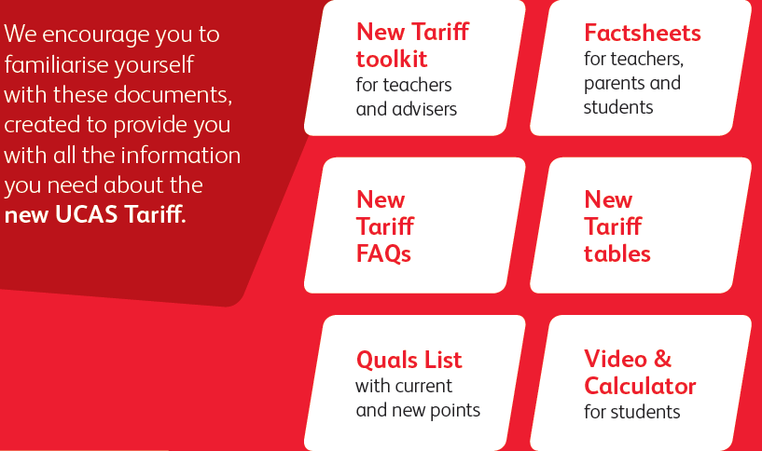
Resources
Resources currently available to support the transition, referred to in this presentation, are available on our website at www.ucas.com/advisers/tariff-2017.
Notes:
We have produced a suite of resources specifically aimed at supporting teachers and advisers through this transition period.
Toolkit1 is a ready-made presentation that you can use to raise awareness within your schools and colleges and this Toolkit 2 goes into more detail about the impact of this change on university entry requirements and offer making
Fact sheets - provide a summary of the key changes
FAQs responding to some of the key questions – this is something we would be happy to expand upon so do let us know if you think of an additional FAQ that would be of help.
The new Tariff tables, and more technical qualifications list, explain all of the tariffed qualifications.
Most recently, we have produced a video aimed at students and a calculator. A clear caveat of the calculator is that learners should always contact the provider and that not all universities use the Tariff etc.

Slide 17
New Tariff video
UCAS has produced a video for learners to explain the new Tariff.
It is available on ucas.com

Slide 18
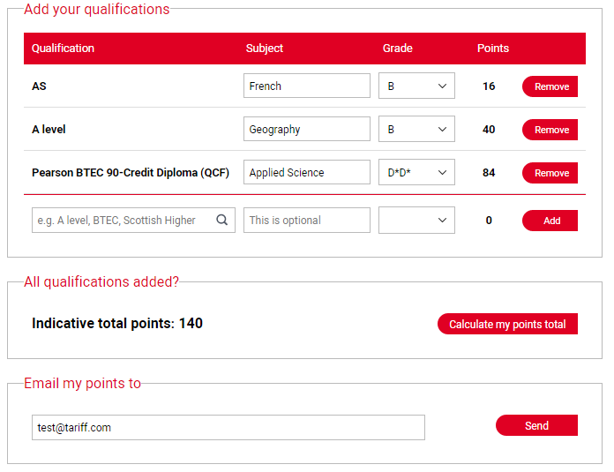
New Tariff calculator

Slide 19
Practical tips
Old and new A levels/AS
Display of BTECs
Finite scale
Not all unis use the Tariff
Check entry requirements
Notes:
Here are some practical tips for teachers and advisers who are getting to grips with the new points system:
The rationale for one switchover is based on the fact that the qualification regulators have stated for some time that the AS is not the same standard as an A level. The fact that the AS was allocated Tariff points at 50% of an A level was a criticism of the current Tariff highlighted in the Qualifications Information Review. UCAS decided to change the points allocated to the AS to 40% from September 2017 to ensure that all learners choosing to study an AS qualification had at least one year’s notice before starting an AS that this change would take effect.
Some qualifications have been prioritised on the drop-down menu on the new Tariff calculator because there are lots of variations of similar titles. For example, BTEC and CACHE qualifications.
The new Tariff grade band allocation is based on a finite scale. In some instances, you may see some grades of qualifications getting the same number of points. So, grades D1 and D2 of the Cambridge Pre-U Diploma are both within the highest grade band, at the top of Level 3/SCQF Level 6, so they attract the same points.
Around one third of courses in the UCAS search tool list a Tariff entry requirement. We don't expect to see a sudden increase or decrease in use of the Tariff. However, some universities and colleges are moving towards qualifications and grade-based entry requirements.
It’s really important to check the entry requirements for the course(s) that the learner is interested in. If you have any questions, talk to the university or college

Slide 20
To recap
UCAS is introducing a new Tariff for the 2017 admissions cycle – one switchover point for both reformed and unreformed AS and A levels.
The new Tariff addresses the shortcomings of the current model.
Very different method to the current Tariff, and the new Tariff numbers are much lower.
Key principle is that of minimum disruption, apart from the AS repositioning to 40% of an A level.
The primary purpose of the new Tariff is to provide a broad metric for universities, which they can use for management information and reporting purposes to HESA.
Approximately one third of courses in our search tool use the Tariff currently and we are not expecting more universities to start using the new Tariff.
Notes:
To re-cap:
For applicants applying in 2016 and entering HE in 2017, the current Tariff will be replaced by the new Tariff. This entails one, singular switchover point for all, regardless of when the qualification was studied, which we hope will minimise confusion. This therefore affects your current year 12 students.
The decision to change the Tariff dates back to the 2012 QIR, where it was deemed that the current Tariff is no longer fit for purpose. Many reasons were cited including its inflexibility to accommodate VQs and international qualifications, expensive and complex methodology and a lack of transparency in determining points allocations. We believe that the new Tariff addresses all of these concerns.
Moreover, a defining principle has been that of minimal disruption, so relationships between qualifications on the Tariff have been maintained as far as possible. The only key change is that of repositioning the AS in line with UK regulator statements that its demand is inferior to that of the A level.
As part of this project, we have also been keen to emphasise that we are no way anticipating an increase in providers using the UCAS Tariff for entry requirements/ offer making. In fact, we have tried to reposition this metric as primarily in existence for the purpose of data management. Therefore, requirements and offers will continue to be expressed in subjects and grades where this is the case at the moment.

Slide 21

Keep Calm!
Notes:
The key point here is that whilst a lot has changed, the new Tariff in itself is simply a simple, qualification metric, which should not effect university entry requirements.
Although the Tariff numbers from 2017 will look and feel very different, the qualification requirements which they represent will not change as a result.
Notwithstanding this, we are acutely aware that this change does have the potential to worry learners, who will have sight of very different numbers. So, with this in mind, we are really keen to reach out to teachers and advisers to ensure that we are supporting you in supporting them in understanding this change.

Slide 22
Appendix: quick reference new Tariff grade combinations

Slide 23
New Tariff points – examples of grade combinations
The following slides provide examples of total new Tariff points for certain grade combinations for a small range of qualifications. All new Tariff points can be found in the new Tariff qualifications list.
A level grade
A level grade | Old Tariff | New Tariff
A*A*A* | 420 | 168
A*A*A | 400 | 160
A*AA | 380 | 152
AAA | 360 | 144
AAB | 340 | 136
ABB | 320 | 128
BBB | 300 | 120
BBC | 280 | 112
BCC | 260 | 104
CCC | 240 | 96
CCD | 220 | 88
CDD | 200 | 80
DDD | 180 | 72

Slide 24
New Tariff points – examples of grade combinations
BTEC Extended Diploma
Grade | Old Tariff | New Tariff
D*D*D* | 420 | 168
D*D*D | 400 | 160
D*DD | 380 | 152
DDD | 360 | 144
DDM | 320 | 128
DMM | 280 | 112
MMM | 240 | 96
MMP | 200 | 80

Slide 25
New Tariff points – examples of grade combinations
International Baccalaureate – Higher Level (HL)
Grade (HL) | Old Tariff | New Tariff
777 | 390 | 168
776 | 370 | 160
766 | 350 | 152
666 | 330 | 144
665 | 300 | 128
655 | 270 | 112
555 | 240 | 96
Notes:
IB Diploma – all composite qualifications are treated the same – each part attracts Tariff points e.g. WBQ, Pre-U etc.
Composite parts: Higher and Standard Level (3 of each) plus Core (Theory of Knowledge, Extended Essay and CAS)
Higher level – size band 4 (same as A level)
Standard level – size band 2 (same as AS)
Theory of Knowledge/ Extended Essay – size band 1
All now attract individual Tariff points as individually accredited by Ofqual (aside from CAS as not accredited so no points)
Maximum is 45 = 6 x 7 + 3

Slide 26
New Tariff points – examples of grade combinations
International Baccalaureate – Diploma
Grade (Diploma) | Old Tariff | New Tariff
45 (Max) | 720 | HL = 7,7,7 (168) SL = 7,7,7 (84) EE = A (12) ToK = A (12) 276
38 | 567 | HL = 7,6,5 (136) SL = 7,6,5 (68) EE = B (10) ToK =B (10) 224
25 | 260 | HL = 4,4,4 (72) SL = 4,4,4 (36) EE = C (8) ToK = C (8) 124
Notes:
Examples for complete grade combinations.
Controversial issues:
Lower grades no longer attract Tariff points (1 and 2 for HL and SL), as not deemed at Level 3
Negative impact on its relationship to the A level within the Tariff, new compared to current
Learners can achieve points for components without actually achieving the IB Diploma

Slide 27
New Tariff points – examples of grade combinations
Scottish Advanced Highers
Grade | Old Tariff | New Tariff
AAA | 390 | 168
AAB | 370 | 160
ABB | 350 | 152
BBB | 330 | 144
BBC | 310 | 136
BCC | 290 | 128
CCC | 270 | 120

Slide 28
New Tariff points – examples of grade combinations
Scottish Highers
Grade | Old Tariff | New Tariff
AAAAA | 400 | 165
AAAAB | 385 | 159
AAABB | 370 | 153
AABBB | 355 | 147
ABBBB | 340 | 141
BBBBB | 325 | 135
BBBBC | 310 | 129
BBBCC | 295 | 123
BBCCC | 280 | 117
BCCCC | 265 | 111
CCCCC | 250 | 105

Slide 29
New Tariff points – examples of grade combinations
Cambridge Pre-U (three principal subjects)
Grade | Old Tariff | New Tariff
D1 D1 D1 | N/A | 168
D1 D1 D2 | N/A | 168
D1 D2 D2 | N/A | 168
D2 D2 D2 | 435 | 168
D2 D2 D3 | 420 | 164
D2 D3 D3 | 405 | 160
D3 D3 D3 | 390 | 156
D3 D3 M1 | 375 | 148
D3 M1 M1 | 360 | 140
M1 M1 M1 | 345 | 132
M1 M1 M2 | 331 | 128
M1 M2 M2 | 317 | 124
M2 M2 M2 | 303 | 120
Notes:
Composite qualification: Principal Subjects + Global Perspectives and Research (GPR)
Both Principal subjects and GPR are size band 4 (same as A level)
To achieve Pre-U, need 3 Certificates +GPR
Controversial points:
Same points achieved at top end of scale (D1 and D2), as those superseding that are deemed to be Level 4

Slide 30
New Tariff points – examples of grade combinations
Access to HE Diploma (45 credits)
Grade credit profile: number of credits at each grade |  |  | New Tariff points
Distinction | Merit | Pass
45 | 0 | 0 | 144
39 | 3 | 3 | 134
36 | 6 | 3 | 131
36 | 3 | 6 | 128
33 | 3 | 9 | 122
30 | 6 | 9 | 118
27 | 9 | 9 | 115
27 | 6 | 12 | 112
27 | 0 | 18 | 106
21 | 9 | 15 | 102

Slide 31
New Tariff points – examples of grade combinations
Access to HE Diploma (45 credits) continued…
Grade credit profile: number of credits at each grade |  |  | New Tariff points
Distinction | Merit | Pass
21 | 6 | 18 | 99
18 | 9 | 18 | 96
18 | 6 | 21 | 93
0 | 36 | 9 | 86
15 | 3 | 27 | 83
3 | 24 | 18 | 80
12 | 3 | 30 | 77
12 | 0 | 33 | 74
3 | 15 | 27 | 70
9 | 0 | 36 | 67

Slide 32


Feedback
Please send your feedback on this pack to newtariff-feedback@ucas.ac.uk. Alternatively, contact the UCAS Policy team.
Policy Team
 qualsinfo@ucas.ac.uk
32

